Slide 1

Computers Principles
11 Lecture/ Internet
Civil Engineering Department
College of Engineering / Diyala University/ 2015-2016.
Dr. Qasim Adnan Aljanabi

Slide 2
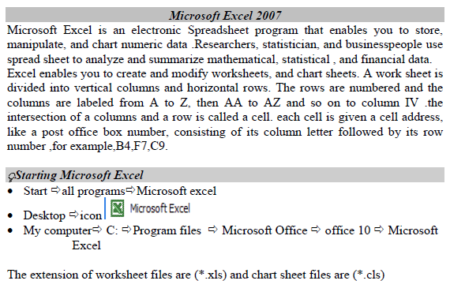

Slide 3
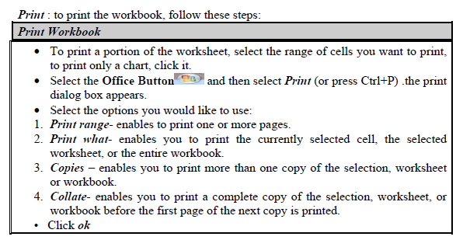

Slide 4
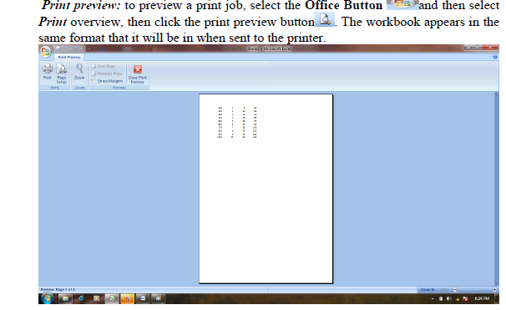

Slide 5
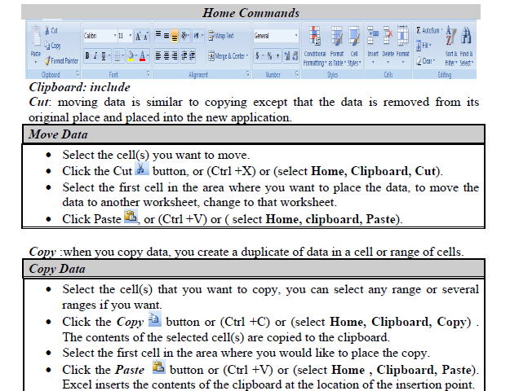

Slide 6
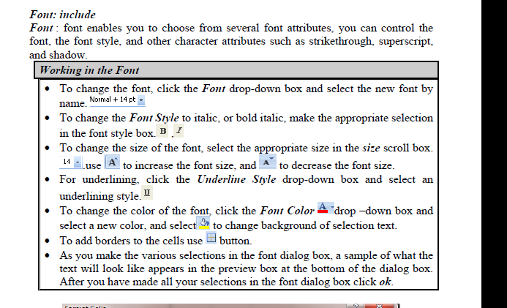

Slide 7
THANK - YOU

